Slide 1


Customer Orders & Performance Analysis
(Olist E-Commerce Brazil)
SQL Capstone Project | Prepared by: Favour Opata

Slide 2
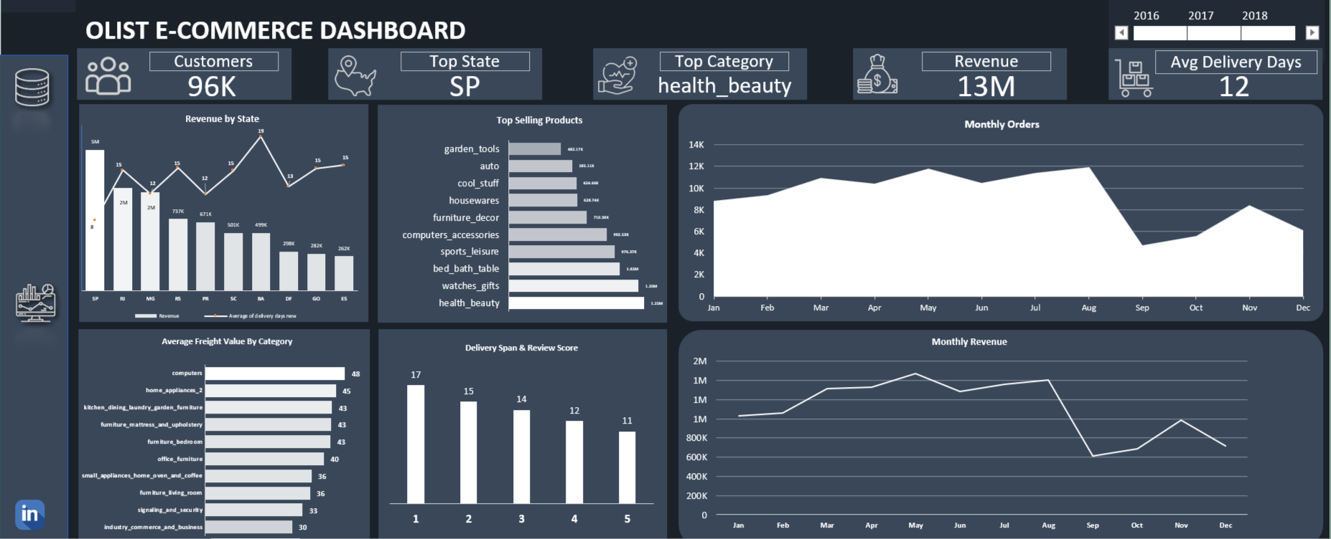

Slide 3
Agenda
Dataset Overview
Objectives
KPIs
Insights & Examples
Conclusion & Recommendations

Slide 4

Data Set Overview
Olist E-Commerce store
The dataset used in this analysis was sourced from Kaggle and originates from Olist, a Brazilian e-commerce platform that operates across multiple marketplaces. It contains transactional data from approximately 100,000 customer orders made between 2016 and 2018. The dataset provides a detailed view of e-commerce activity in Brazil, offering insights into order timelines, customer behavior, product characteristics, and post-purchase feedback. For this project, the analysis focused on five key tables: Orders, Customers, Order Items, Products, and Order Reviews. All personal data in the dataset has been fully anonymized to protect user privacy, and the dataset is widely used for educational and analytical purposes in public data science projects

Slide 5
Derive insights through SQL analysis and Excel dashboards
Objectives
This project focused on four core objectives. First, it analyzed customer behavior across states to understand order distribution and geographic concentration.
Second, it evaluated sales performance by identifying high-performing product categories and revenue patterns.
Third, it assessed delivery timelines and examined how delays affect customer satisfaction, as reflected in review scores. Lastly, the project used SQL to conduct structured analysis and Excel to create dashboards, ensuring that insights were both data-driven and easy to interpret.
Analyze customer behavior by state and order trends
Assess delivery speed and its impact on reviews
Evaluate sales volume and category-wise revenue

Slide 6

Key Performance Indicators
Key KPIs
Unique Customers:
95,978
Top State by Orders:
SP (40,501)
Top Revenue Category:
Health & Beauty
Total Revenue:
13M

Slide 7
Sao Paulo (SP) generates the highest revenue of 5million and also has the shortest average delivery days. This reveals operational excellence
SP delivers 4 days faster than the national average – a 33% Improvement
Insights
Sao Paulo (SP)

Slide 8
As delivery time increases, review score consistently drops
A 6- day difference is associated with a fall from 5 stars to 1 star
Customers expect delivery within 11 to 12 days to give good ratings, delays beyond 14 days sharply increase negative reviews(1-2 days)
Fast delivery is the strongest driver of positive reviews.
Insights
Impact of Delivery mirroring Review Scores

Slide 9
The Health and personal Care Category generated approximately 1.25 million in revenue during the analysis period, making it the top performing category by sales
Despite not having the highest order volume, its high unit prices and strong repeat customer behavior drives its revenue dominance
This performance suggests strong consumer demand for wellness related products and a higher profit margin compared to other categories
Insights
Best Performing Product Category

Slide 10
Conclusion
The analysis of Olist’s Brazilian e-commerce dataset from 2016 to 2018 reveals key operational and customer behavior patterns that can drive strategic decisions. São Paulo (SP) not only recorded the highest number of orders and total revenue (~₦5 million), but also achieved the shortest average delivery time across all states, indicating strong logistics and fulfillment systems.
A clear link was found between delivery speed and customer satisfaction review scores improved as delivery span shortened, with 5-star reviews averaging 11 days compared to 17 days for 1-star reviews. The Health & Personal Care category emerged as the top revenue generator, pointing to strong demand for wellness products. Additionally, the majority of orders were placed in the months of May to August, suggesting seasonal demand trends. These insights reinforce the value of operational efficiency, category prioritization, and understanding customer expectations in improving performance.

Slide 11
Recommendation
Olist should replicate SP’s logistics strategies in other high-potential regions to reduce delivery times and improve customer satisfaction. Priority attention should be given to the Health & Personal Care category by expanding product offerings, ensuring steady inventory, and tailoring marketing efforts.
To address delivery-related dissatisfaction, especially among low review scorers, the company should enhance order tracking transparency, carrier performance monitoring, and preemptive communication on delays. Finally, leveraging seasonal demand patterns through targeted promotions in peak months (e.g., May–August) could significantly boost sales and customer retention.

Slide 12
THANK YOU

